Slide 1

Attendance Management System
Final Year Project

Slide 2

Supervisor
Sir. Anwar Hussain
Project By
Shah Fahad
Shehryar Javed
Salman Khan
Roll No 11
Roll No 30
Roll No 51

Slide 3
Introduction
Our project is an Attendance Management System designed to simplify and automate attendance tracking within universities. It offers a user-friendly interface and accommodates multiple user roles for effective management. This system improves efficiency, accuracy, and data security in attendance monitoring, making it an essential tool for administrators, teachers, and students.

Slide 4
Objectives
Improve attendance monitoring accuracy and efficiency.
Reduce manual attendance record-keeping.
Enhance data security.
Easy access for administrator and student to attendance

Slide 5
Need for Attendance Management System
Manual attendance tracking is time-consuming and prone to errors.
Difficulty in maintaining attendance records for large student populations.
Lack of real-time data for teachers and administrators.
Inefficient communication between teachers and students regarding attendance.
Security concerns.

Slide 6
Our Solution
Our solution is an Attendance Management System built using the MERN Stack (MongoDB, Express.js, React, Node.js) that simplifies the attendance tracking process.
Student can easily view their attendance and teacher can take attendance faster and efficiently.

Slide 7
Key Features
Secure User Registration and Authentication.
Email-Based Account Verification and Password Reset.
Real-time Attendance Tracking.
Role-based Access Control.
Attendance Security
Secure Signup
PWA (Progressive web app)

Slide 8
How it works
Super Admin creates Department and add department admin
Department Admin Creates Batches, Semester and Subjects
Department Admin add teachers through email
Department Admin assign subject to a teacher
Student signup using a Batch Code
Teacher takes attendance in a subject assigned to them
Admins and teacher can see all the saved attendance
Student see their attendance and percentage

Slide 9
System Architecture
MongoDB
ExpressJS
Our database choice, MongoDB, is a NoSQL database known for its flexibility and scalability. It allows us to store and manage data efficiently, making it suitable for complex data structures such as user profiles, attendance records, and more.
As the backend framework, Express.js simplifies the development of APIs and routes, enabling smooth communication between the frontend and backend components of the system.

Slide 10
System Architecture
ReactJS
NodeJS
The frontend of our system is developed using React, a JavaScript library for building user interfaces. React's component-based architecture ensures a responsive and dynamic user experience.
Node.js serves as the runtime environment for our server. It supports the execution of server-side JavaScript code, ensuring high performance.

Slide 11
Website Features

Slide 12
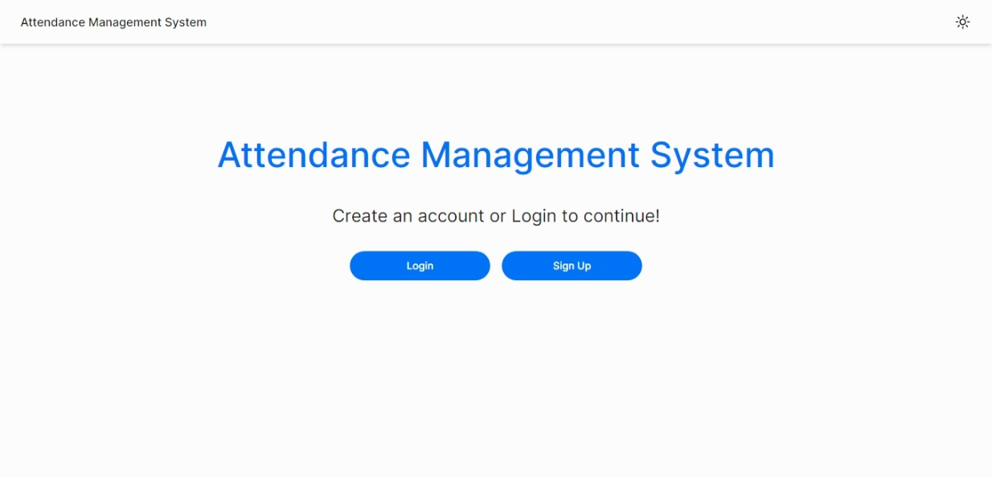
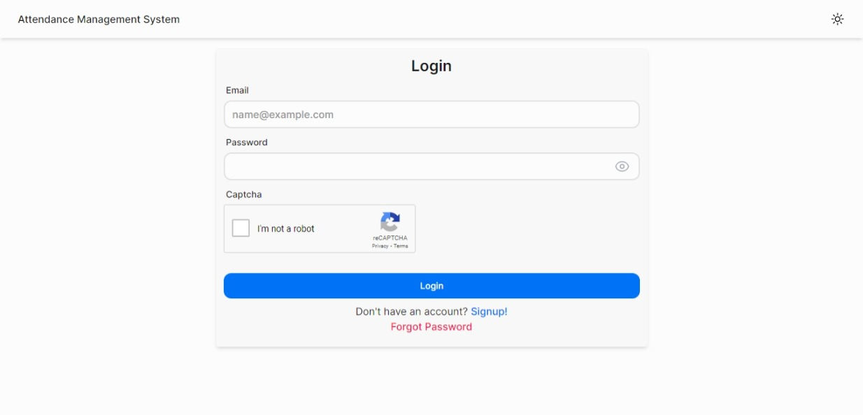
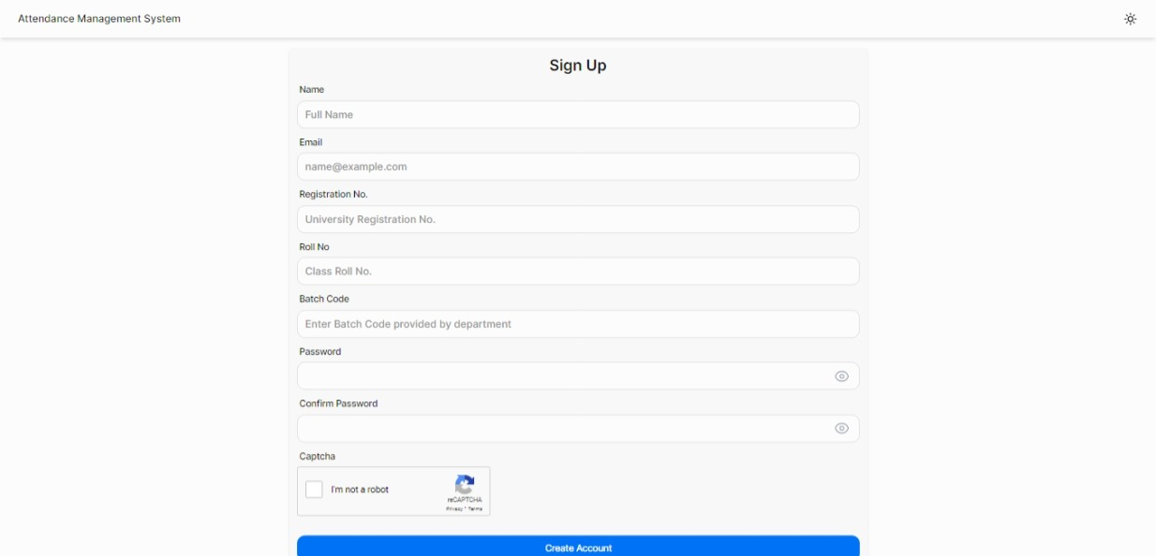
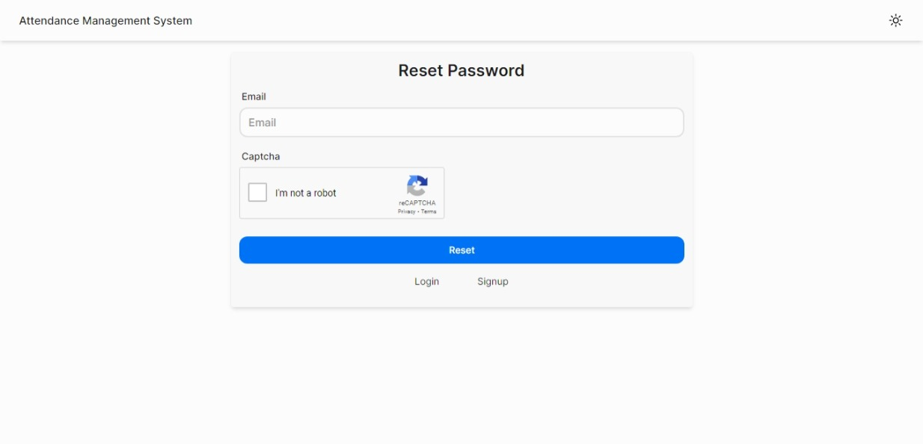

Slide 13
User Roles
Student
Teacher
Department Admin
Super Admin

Slide 14
1. Student
Student can sign up using a batch code provided by admin
After logging in, student can select semester and subject and semester to view their attendance

Slide 15
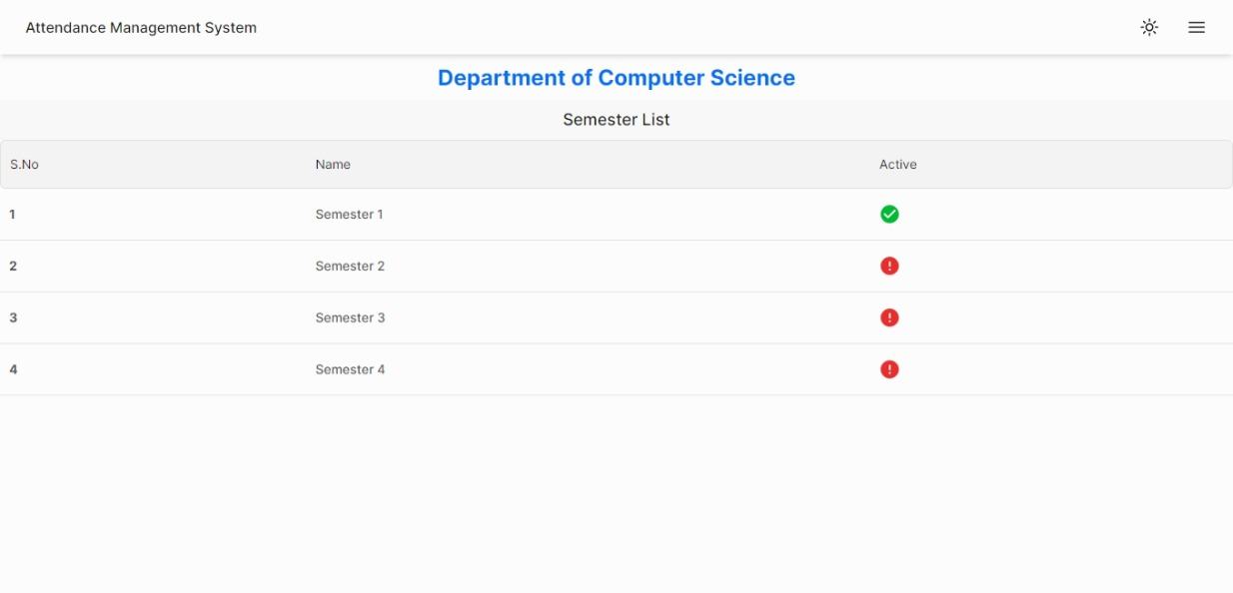
After logging in, student can select a semester to view its subjects

Slide 16
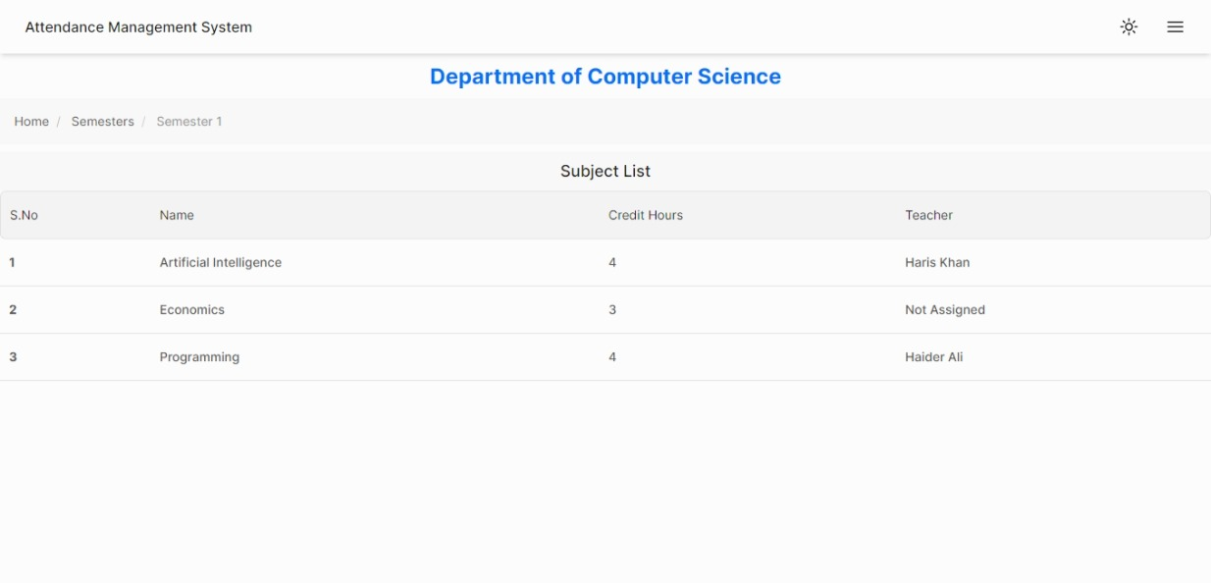
After selecting a semester, its subject will be shown which student can select to see their attendance in that subject

Slide 17
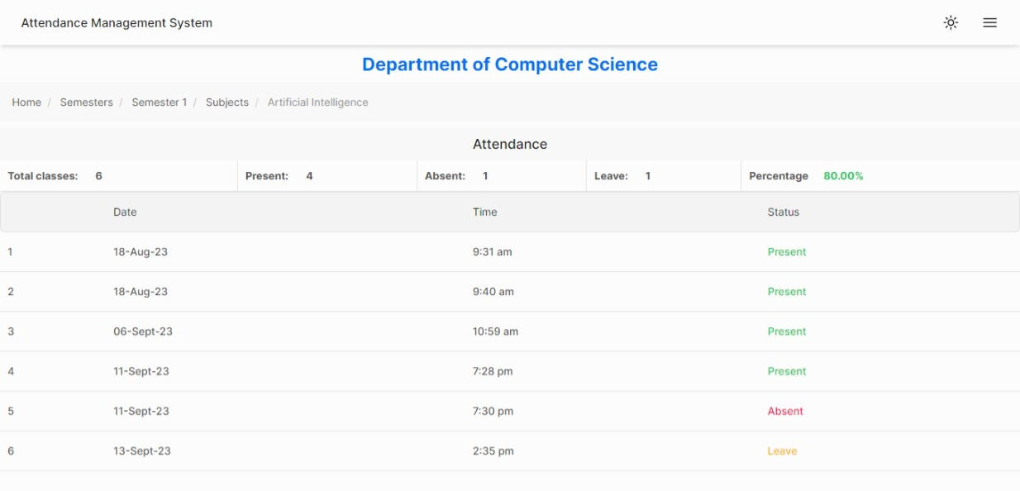
After selecting a subject, attendance for each date will be shown.

Slide 18
2. Teacher
Teacher can be added by department.
An email will be sent which will include their login details.
Teacher can view subjects assigned to them and take attendance in them.

Slide 19
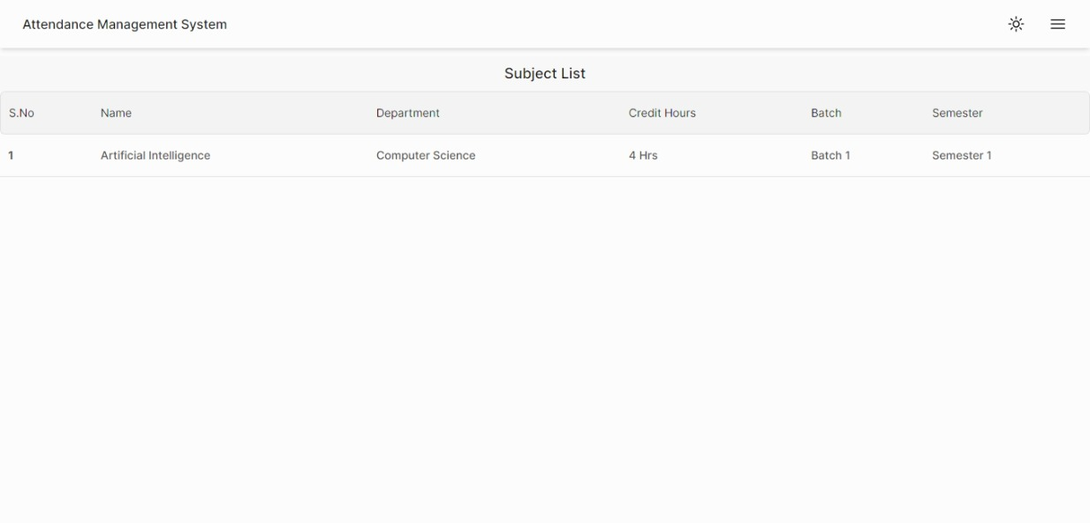
After logging in, teacher will see all the subjects assign to them

Slide 20
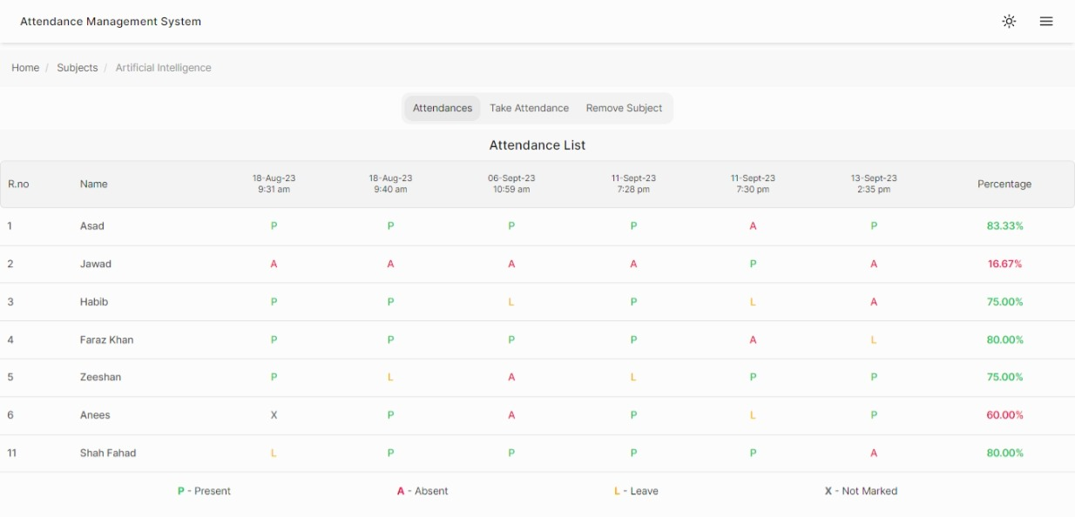
After selecting subject, its attendance will be shown. Teacher will also have options to take attendance

Slide 21
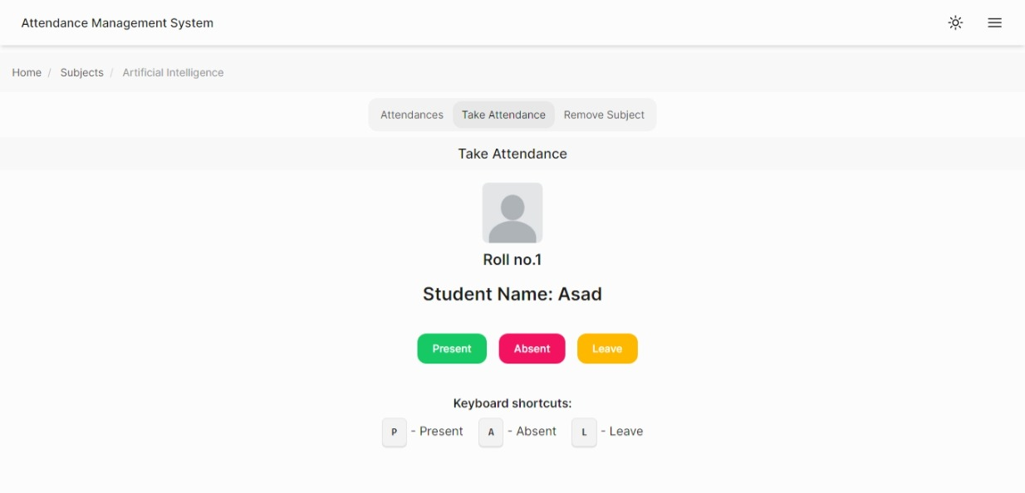
When Take Attendance is clicked, student will be shown one by one. Teacher can use keyboard shortcuts to mark attendance as well

Slide 22
3. Department Admin
Department admin can be added by super admin.
An email will be sent which will include their login details.
Department admin can add/edit/delete batches, semesters and subjects.
They can add teachers of their departments

Slide 23
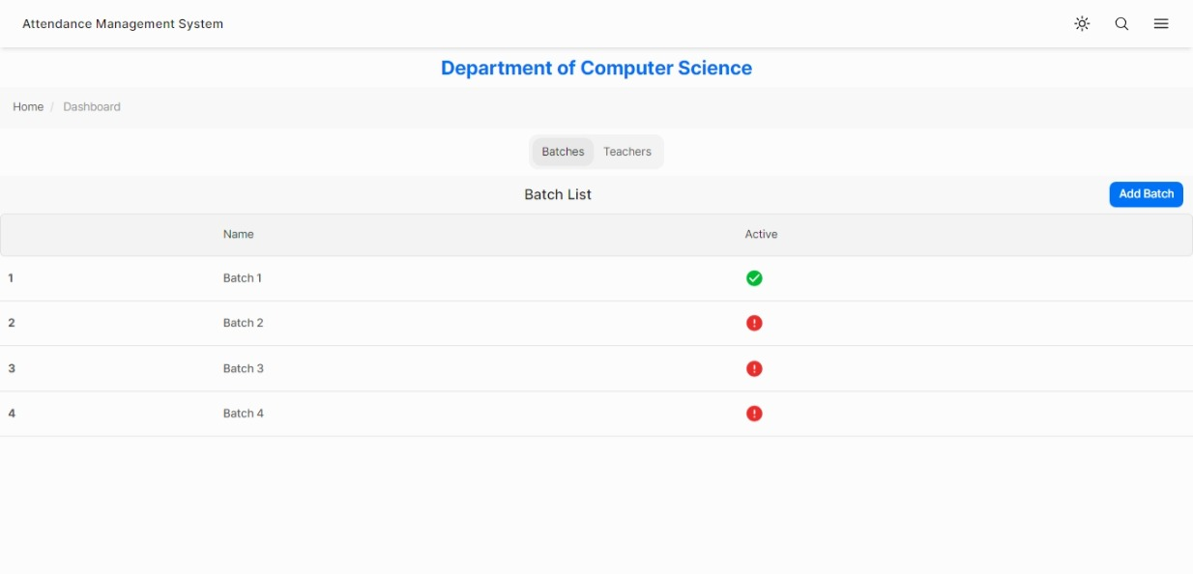
When department admin log in, all the batches in department will be shown

Slide 24
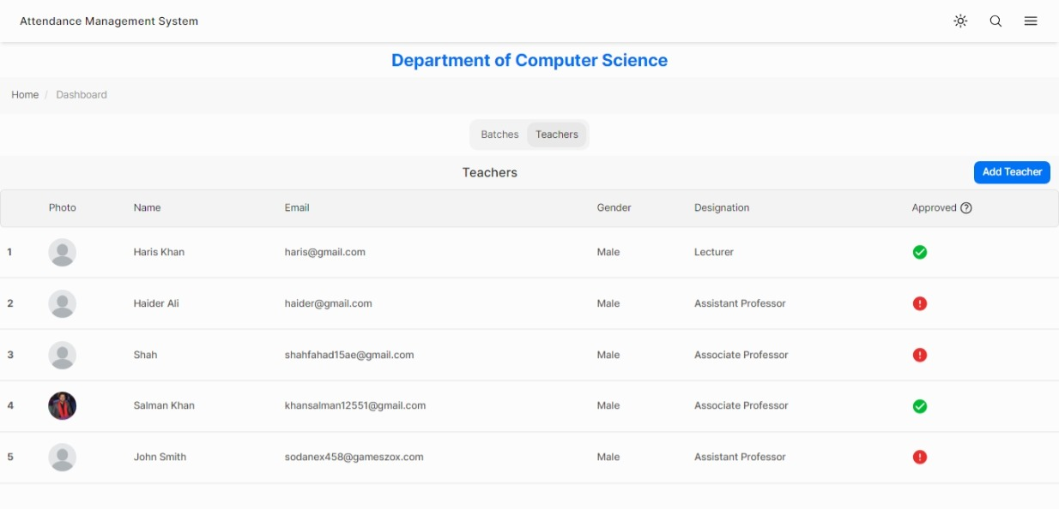
On clicking ‘Teachers’, teachers in department will be shown

Slide 25
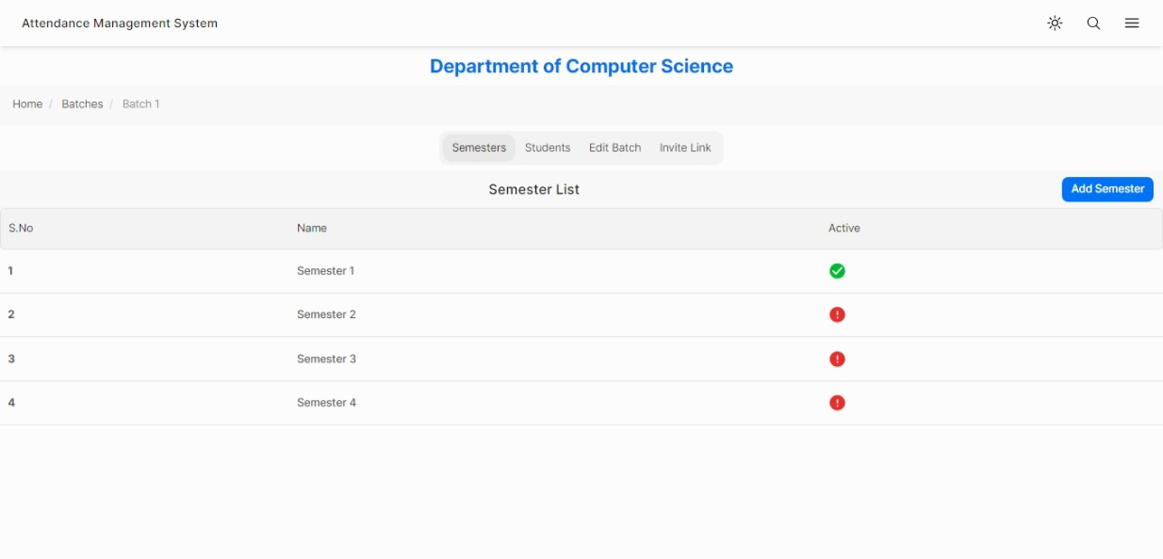
On clicking batch, its semesters will be shown. Menu will contain options for viewing students of batch and invite link

Slide 26
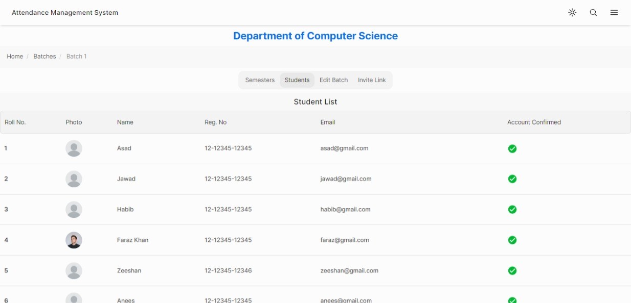
Student List

Slide 27
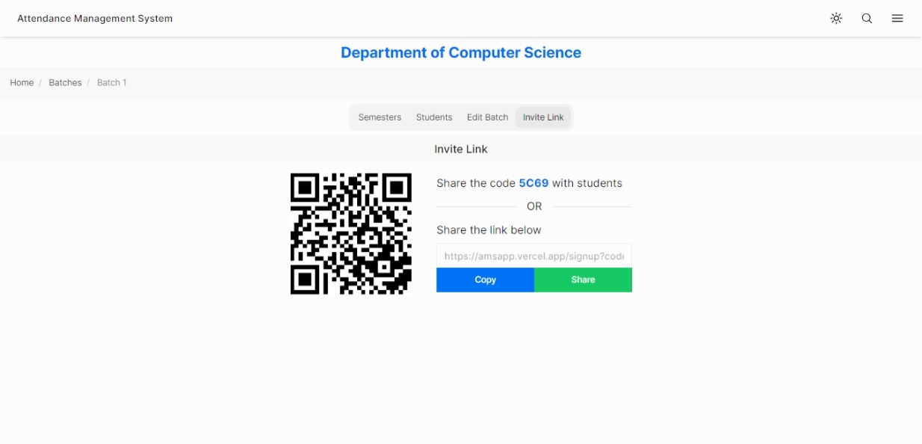
Invite link can be sent to student so they signup. After signup, student will be added in the batch

Slide 28
4. Super Admin
Super admin can create departments and assign department admin.
They can perform all the actions that admin can do as well.

Slide 29
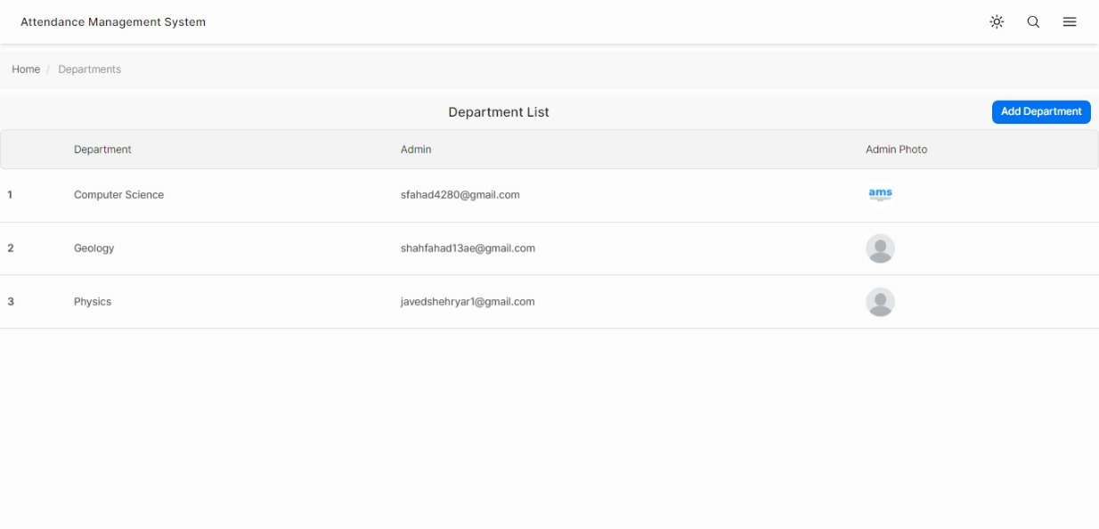
When super admin log in, all departments will be shown.
Department List

Slide 30
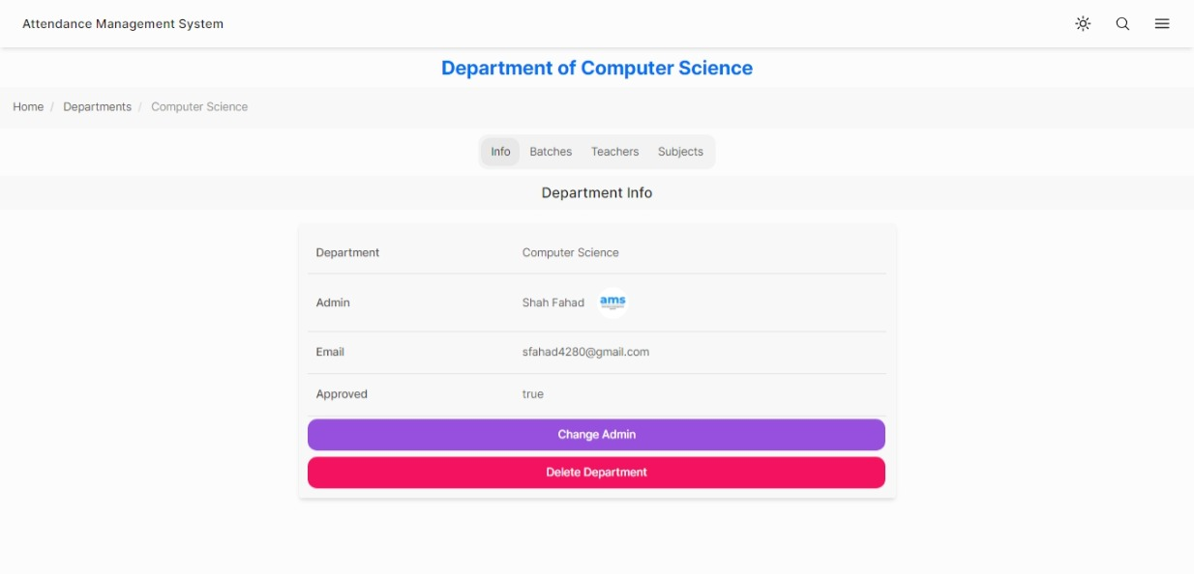
When a department is clicked, its info will be shown. Men will contain options for its batches, teachers and subjects
Department Info

Slide 31
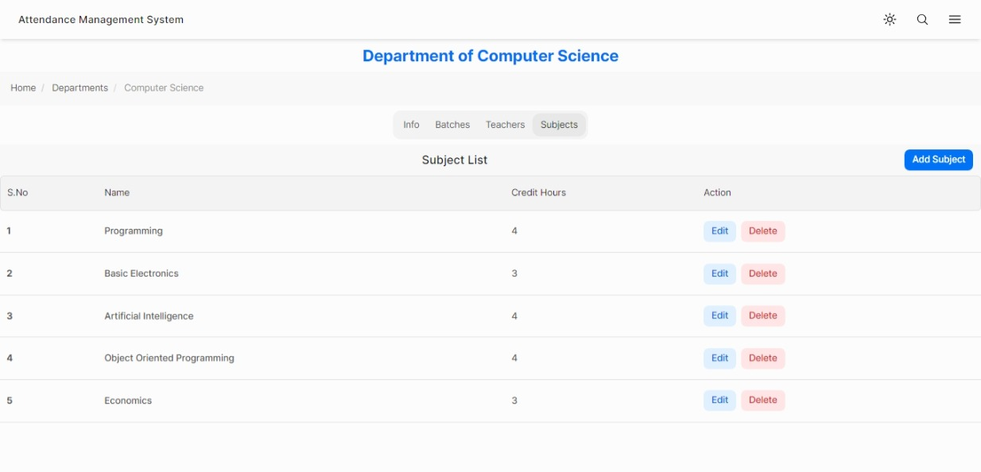
All subjects of a department can be added here. Department admin can select a subject from this when adding subject to a semester

Slide 32
Emails

Slide 33
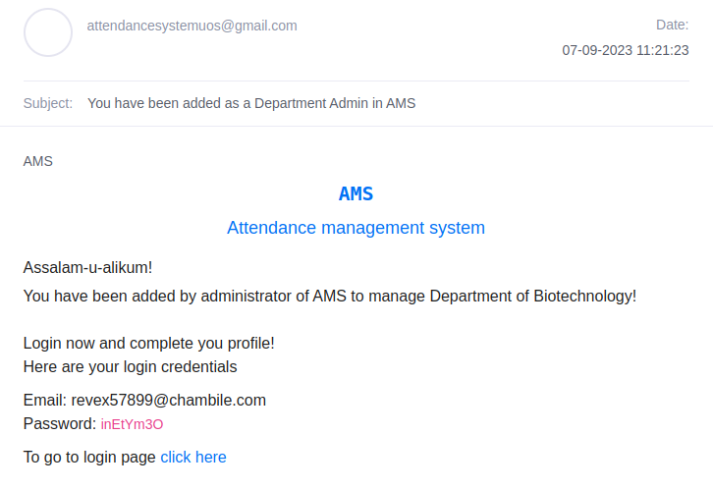
Email sent to Department admin when they are added by super admin

Slide 34
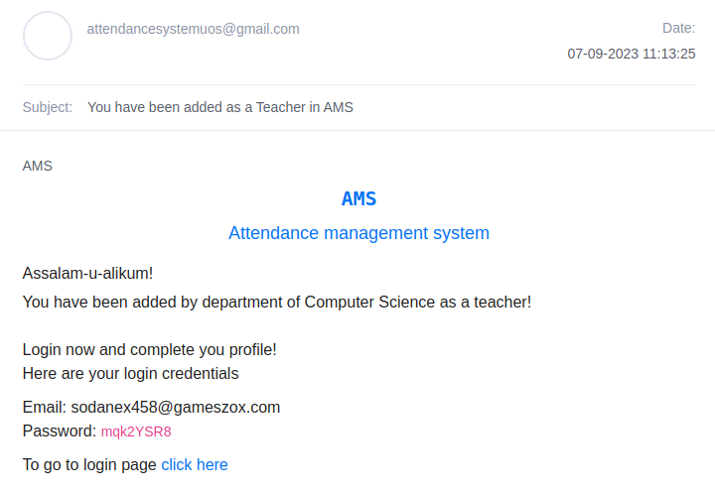
Email sent to teacher when they are added

Slide 35
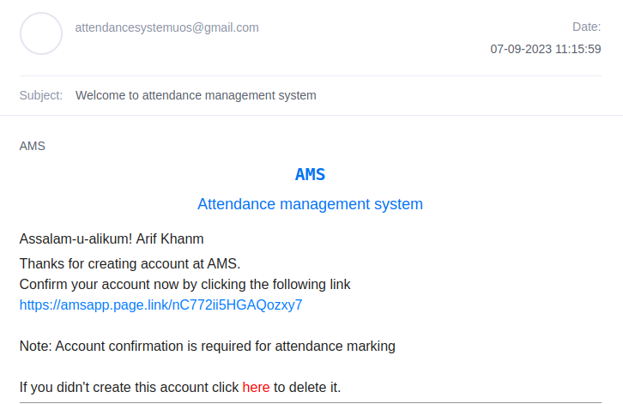
Email to student on signup

Slide 36
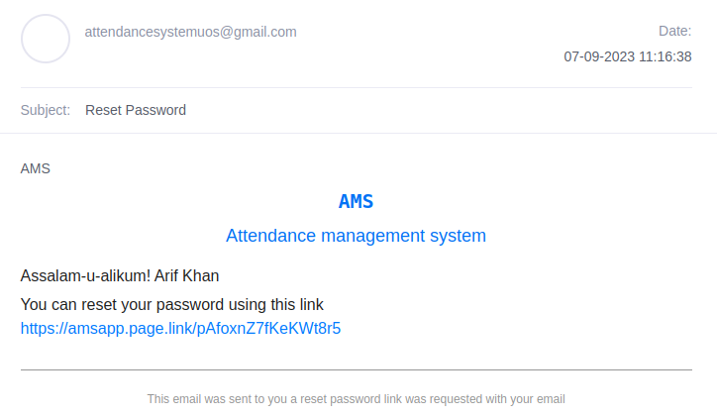
Email sent when user requests password reset

Slide 37
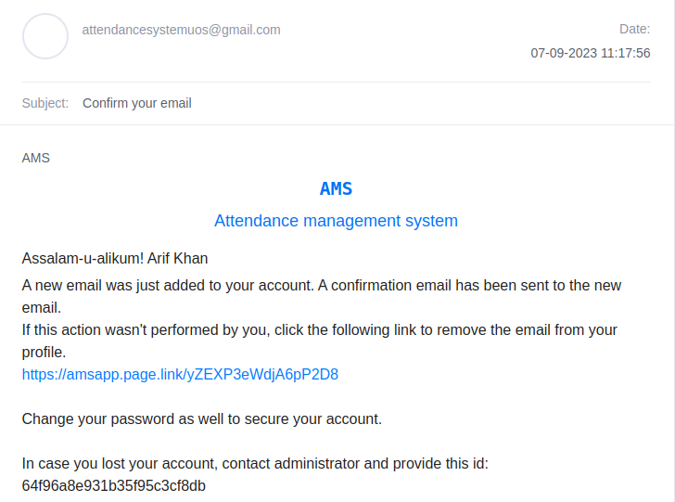
When user change their email

Slide 38
Future Enhancements
Mobile app
Machine Learning algorithms
Enhanced Reporting
Improved notifications
Improvement through user feedback

Slide 39
We would like to thank our department and especially our supervisor Anwar Sir for their guidance, mentorship and valuable insights.
THANK YOU

